Slide 1
Right Price
An AI-Based Cost Estimation System
By Manmeet Gill, Sidarth Shahri, Manpreet Singh, Karthik Tella
Notes:
Upload a short ppt slide deck (3-4 slides) to cover a 4 minute presentation per group providing an update of where you are on the project. Be sure to include
1) Overall description of the project
2) current challenges
3) a copy of your Gantt and PERT charts. Make sure they are of sufficient size to be read at the back of the room. Words should be no less than 20 point font.
4) the name of the contributor of each slide on the bottom right corner.

Slide 2
Overall Description
Problem: Buying/selling a used or old product online is troublesome
Unsure of the right price to pay/sell item for
Solution: Tool that looks at data from online marketplaces like CraigsList, ebay, Amazon to determine the market price of an item
Data must be processed to ensure accurate information
Result must take into account various factors like brand, model, color, condition, etc.
Notes:
Upload a short ppt slide deck (3-4 slides) to cover a 4 minute presentation per group providing an update of where you are on the project. Be sure to include
1) Overall description of the project
2) current challenges
3) a copy of your Gantt and PERT charts. Make sure they are of sufficient size to be read at the back of the room. Words should be no less than 20 point font.
4) the name of the contributor of each slide on the bottom right corner.

Slide 3
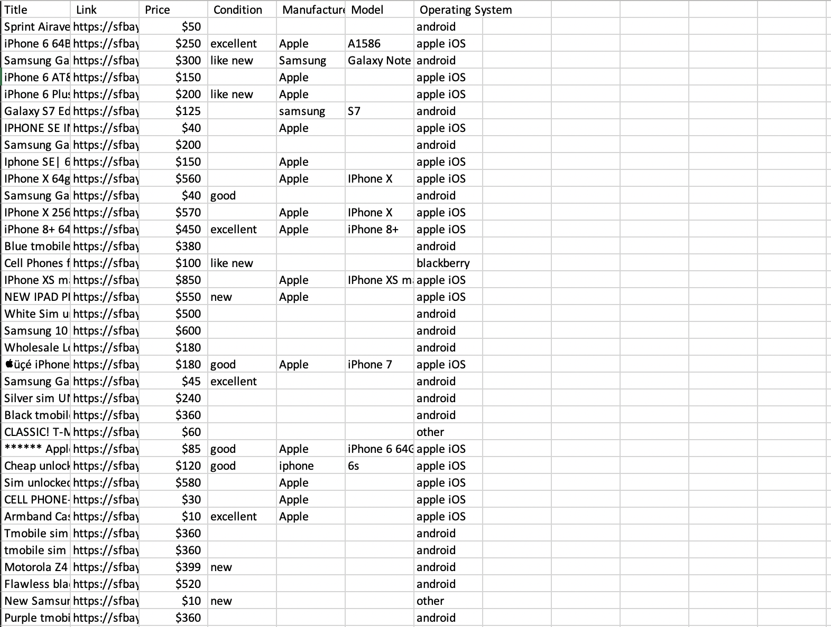
Data Collection

Slide 4
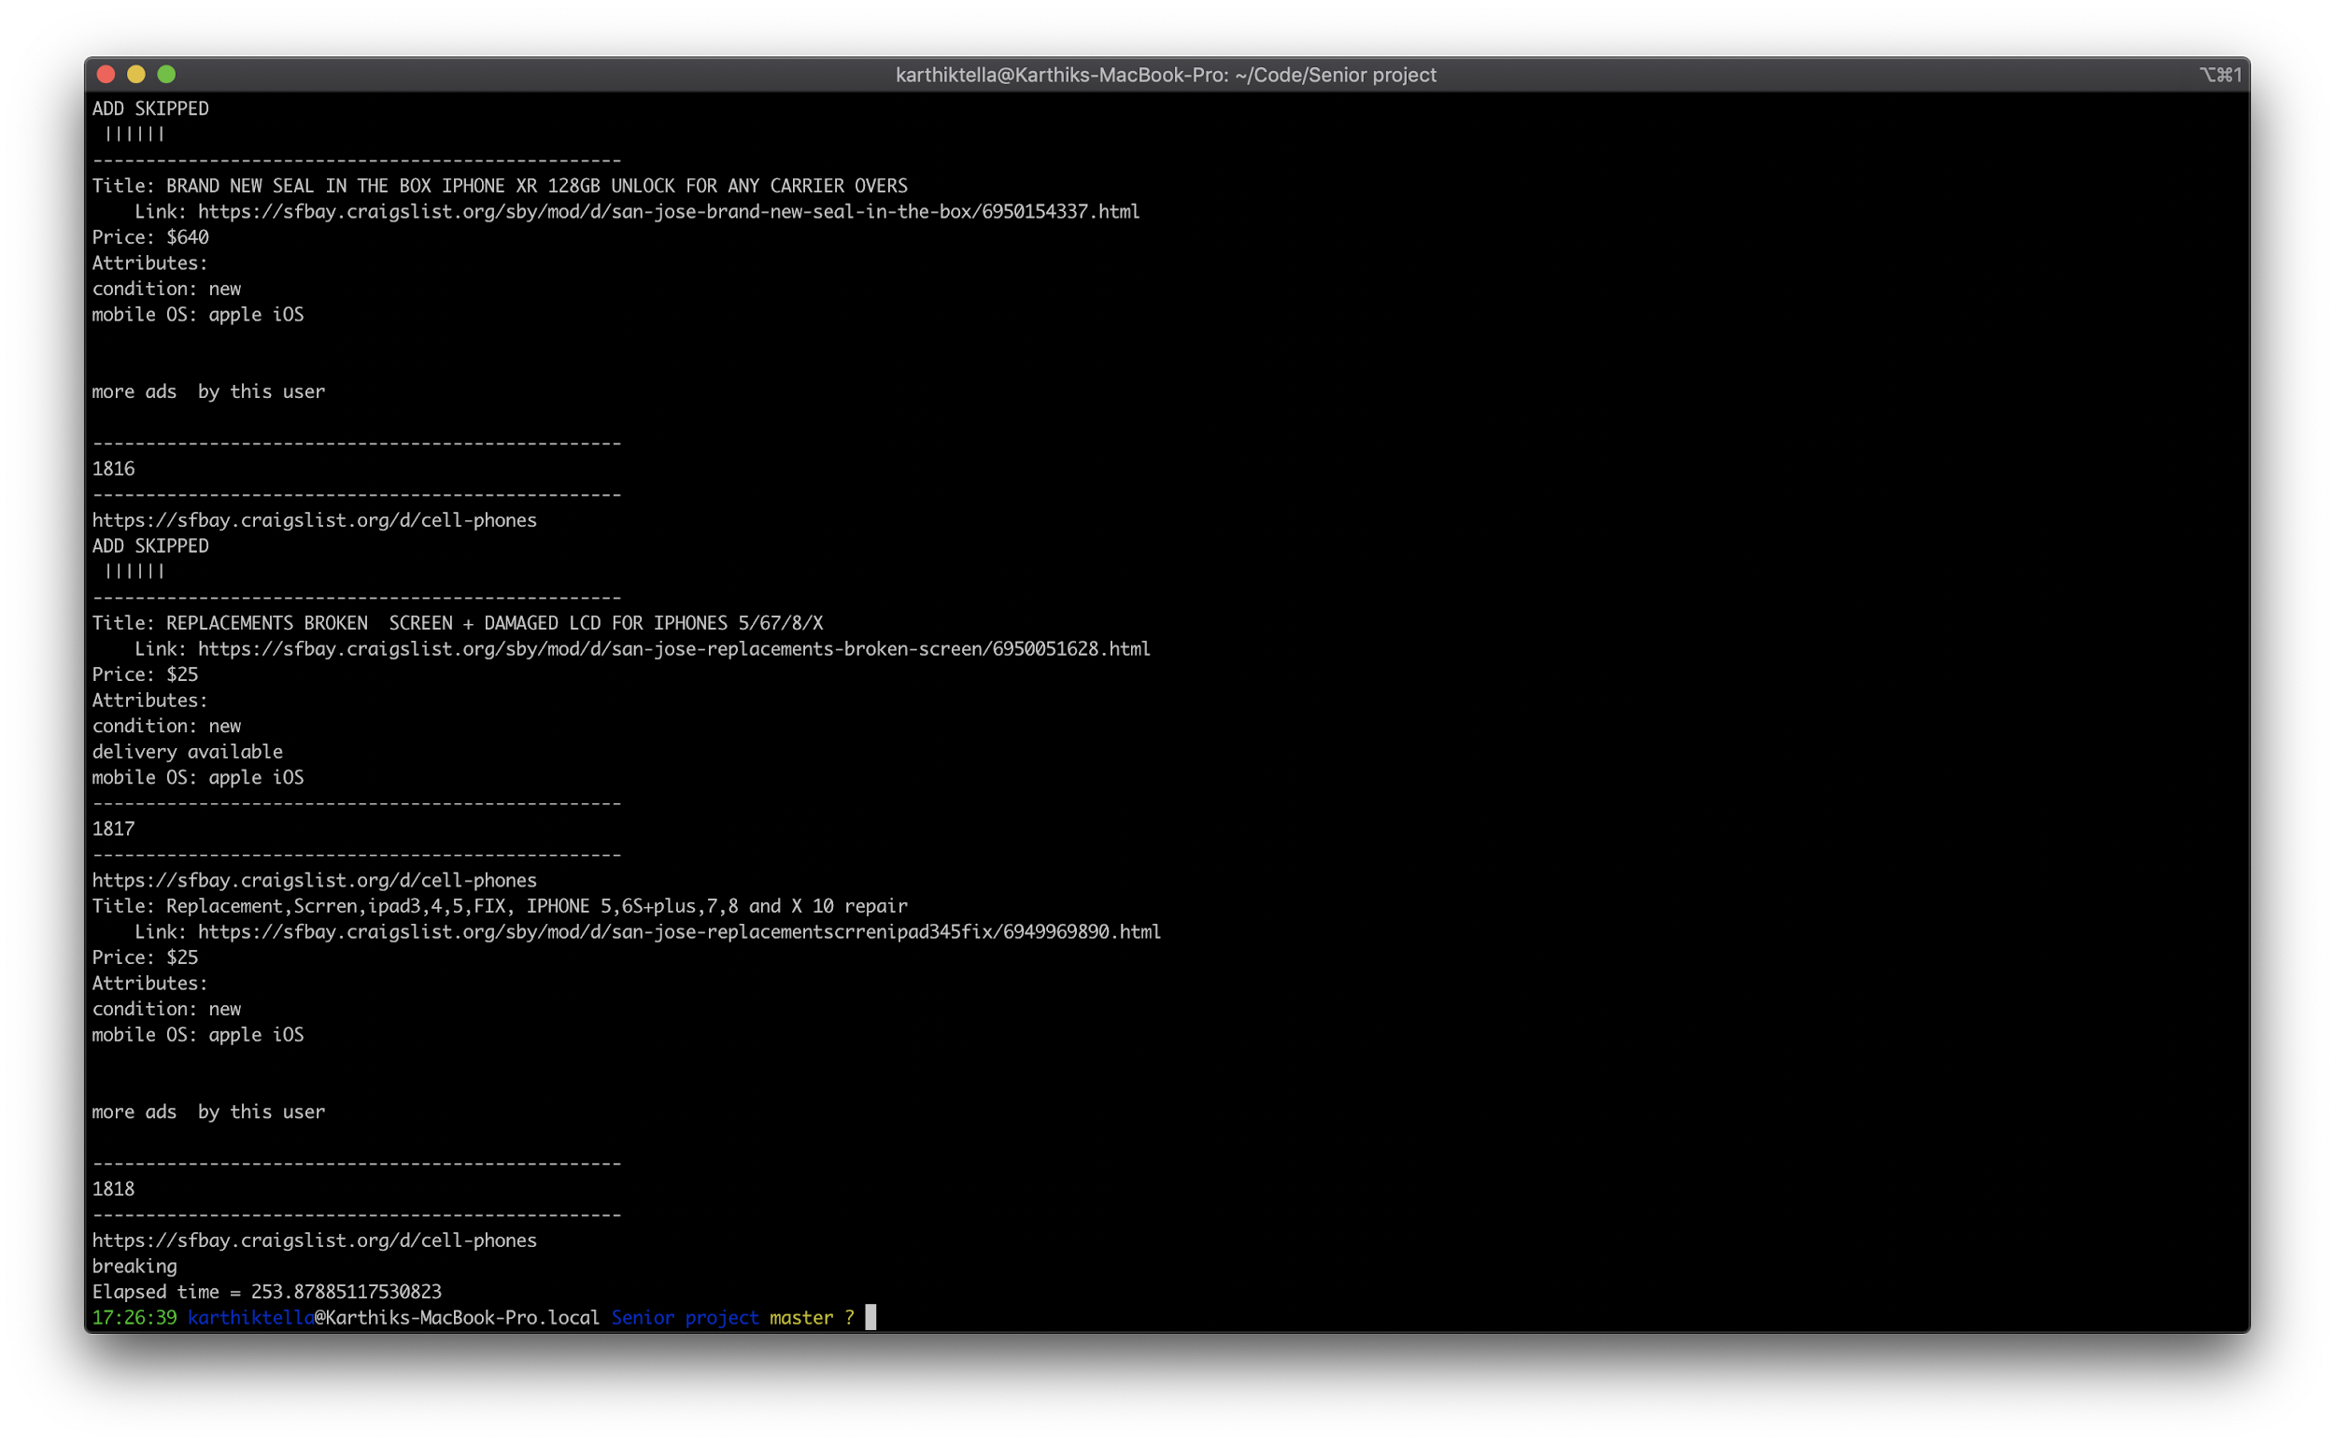
Data Collection

Slide 5
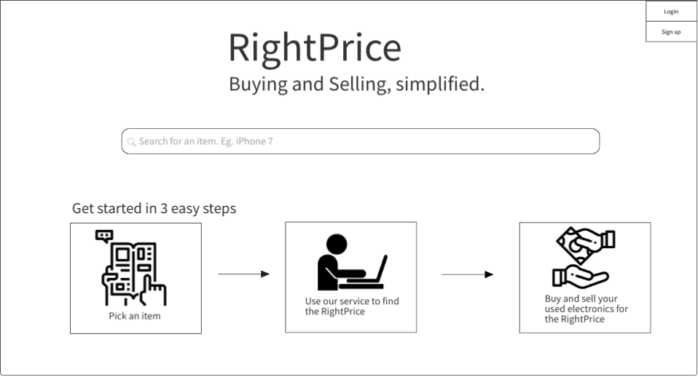
Front-End Wireframe

Slide 6
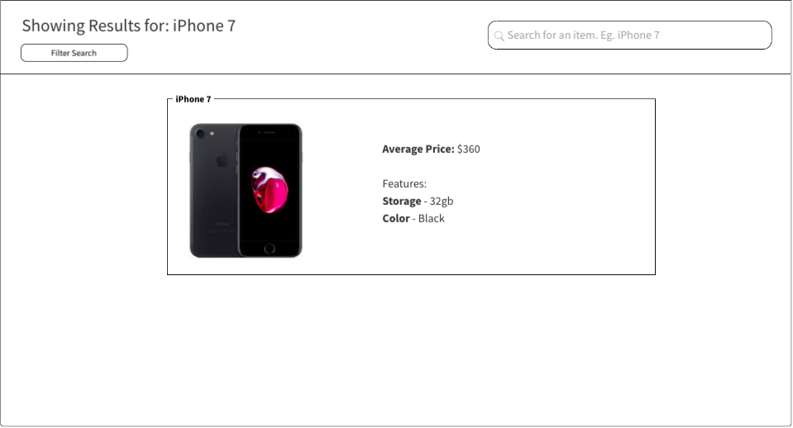
Front-End Wireframe

Slide 7
Current Challenges
Data collection is in progress
Cleaning data using Natural language processing
Refining feature list for the ML model
Applying ML models to the dataset
Notes:
Upload a short ppt slide deck (3-4 slides) to cover a 4 minute presentation per group providing an update of where you are on the project. Be sure to include
1) Overall description of the project
2) current challenges
3) a copy of your Gantt and PERT charts. Make sure they are of sufficient size to be read at the back of the room. Words should be no less than 20 point font.
4) the name of the contributor of each slide on the bottom right corner.

Slide 8
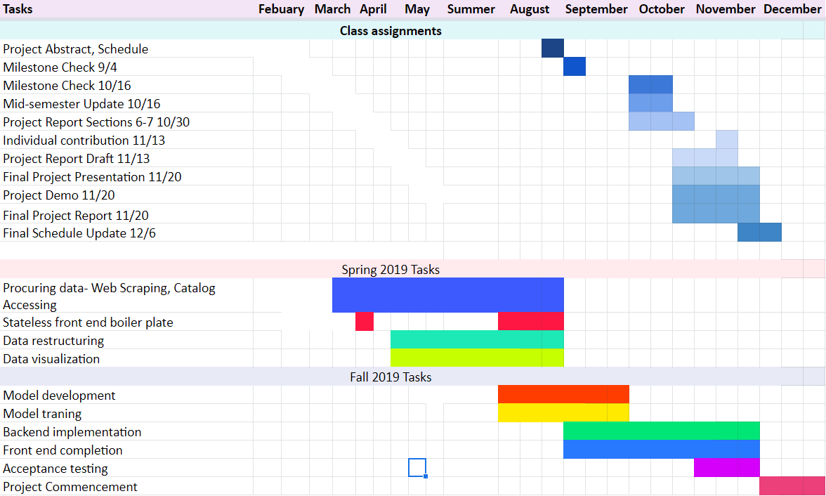
Notes:
Upload a short ppt slide deck (3-4 slides) to cover a 4 minute presentation per group providing an update of where you are on the project. Be sure to include
1) Overall description of the project
2) current challenges
3) a copy of your Gantt and PERT charts. Make sure they are of sufficient size to be read at the back of the room. Words should be no less than 20 point font.
4) the name of the contributor of each slide on the bottom right corner.

Slide 9
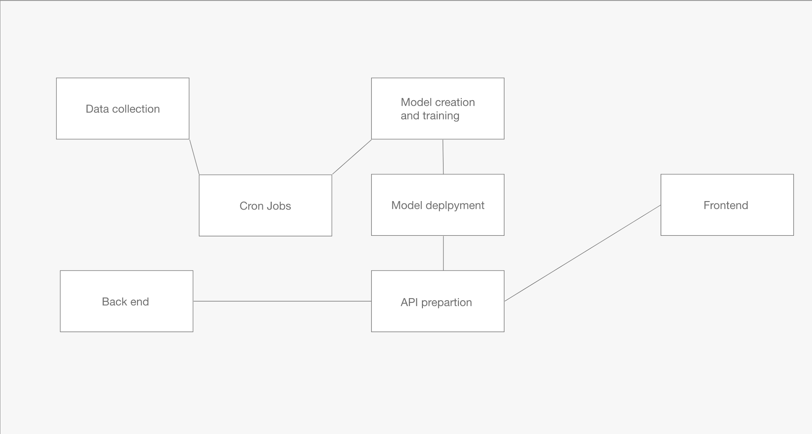
PERT Chart

